Slide 1

Serverless Shootout
Ronnie Hicks
https://about.me/ronniehicks
Ben Main

Slide 2
Terms
AWS – Amazon Web Services
Azure – Microsoft’s cloud offering
GCP – Google Cloud Platform
FaaS (Function as a Service) - platform allowing customers to develop, run, and manage application functionalities without the complexity of building and maintaining the infrastructure typically associated with developing and launching an app
Serverless – refer to FaaS, also any platform that abstracts the infrastructure management away from the customer
Serverless Platform – community product offered by Serverless, Inc, with commercial options, that provides abstractions and dashboard/metrics
Lambda – AWS FaaS
Function App – Azure FaaS
Cloud Function – GCP FaaS
CFN (Cloud Formation) – AWS infrastructure as code
DM (Deployment Manager) – GCP infrastructure as code
ARM (Azure Resource Manager) – Azure infrastructure as code

Slide 3
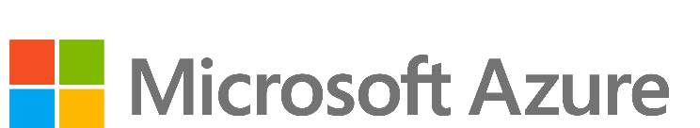
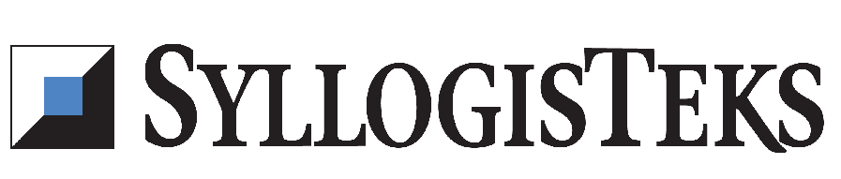

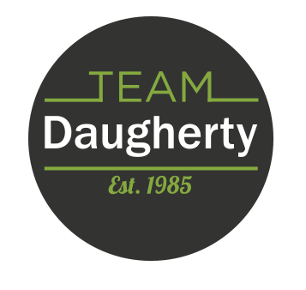


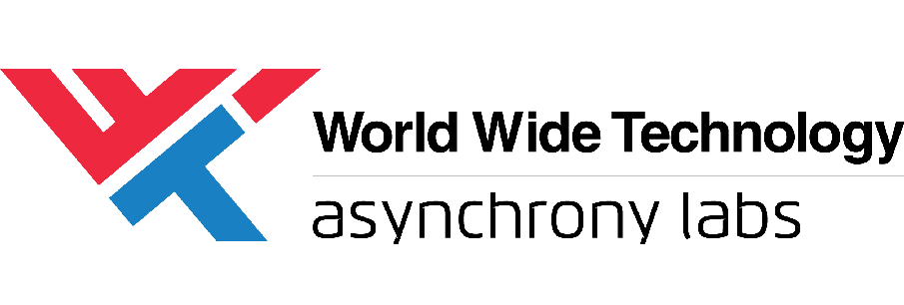


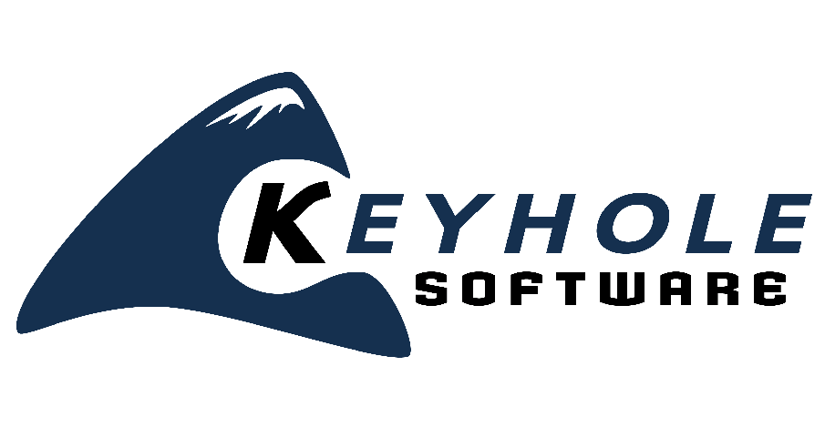




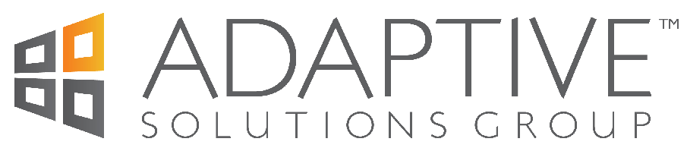


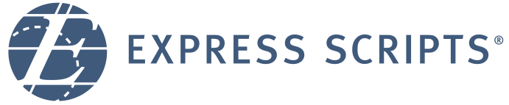
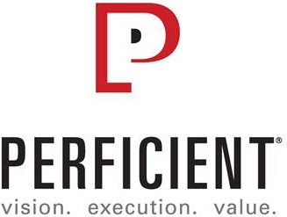


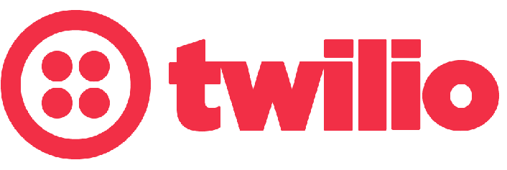




Swag Bags
Platinum Sponsors
Lanyards
Party
Gold Sponsors
Notebooks
Media

